Slide 1


Content Segmentation
Discussion on the use of segmented content & its application in HCP Journeys
Wednesday, March 31

Slide 2
Meeting Context
Meeting Objectives
Prior to developing the HCP Journey maps, alignment is required amongst key Galapagos stakeholders as to the segmentation of existing content, to ensure that:
HCP Journey Maps designed above-market are in line with expectations and usable by the local markets
Messaging conveyed to local markets is consistent
Communicate our understanding of how segmented content can be used to best engage with HCPs
Align on understanding as to the segmentation of Galapagos existing content

Slide 3

Segmented Content – Setting the Stage
When we talk about segmented content, what do we mean?
Segmented content
Content that addresses the specific needs of a customer segment

Slide 4
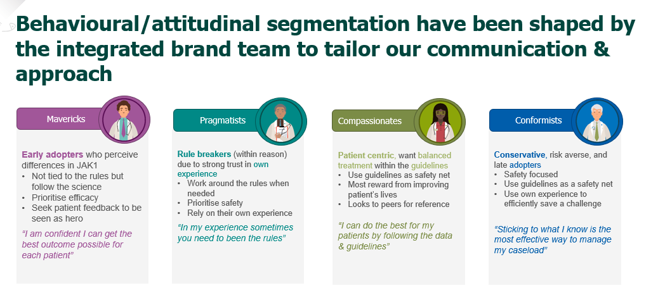
HCP Segmentation Distinctions
While the goal for each of the customer segments is the same – to prescribe JYSELECA and turns HCPs into advocates, the means to achieve this goal differs per segment
HCP Segmentation
Overview:
Early adopters who perceive differences in JAK1
Why does this segment prescribe?
Prescribes early due to interest in latest science/new MOAs/new products
Efficacy focused in assessing new treatments/products
“I am confident I can get the best outcome possible for each patient”
Overview:
Puzzle solvers who have a strong trust in their own experience
Why does this segment prescribe?
Hands-on learners, high likelihood as early prescribers as they want to see the results of new treatments for themselves
Safety focused in assessing new treatments/products
“In my experience, sometimes you need to break the rules”
Overview:
Patient centric, want balanced treatment within the guidelines
Why does this segment prescribe?
Has heard referrals from peers and KOLs as to successes of new MOAs/products
Balance between guideline/safety focused in assessing new treatments/products
“I can do the best for my patients by following the data and guidelines”
Overview:
Conservative, risk averse, and late adopters
Why does this segment prescribe?
Does not regularly prescribe new treatments as they rely on experience to dictate behavior
“Sticking to what I know is the most effective way to manage my caseload”
The RA team has grouped HCPs into four distinct segments based on specified behaviors & attitudes, and to best engage with segments requires the use of segmented content

Slide 5
JYSELECA Launch Strategy – RA
Based on the behaviours of the various segments, JYSELCA’s launch strategy is to focus on the segments that are likely to become early adopters.
Overview:
Early adopters who perceive differences in JAK1
Why does this segment prescribe?
Prescribes early due to interest in latest science/new MOAs/new products
Efficacy focused in assessing new treatments/products
“I am confident I can get the best outcome possible for each patient”
Overview:
Puzzle solvers who have a strong trust in their own experience
Why does this segment prescribe?
Hands-on learners, high likelihood as early prescribers as they want to see the results of new treatments for themselves
Safety focused in assessing new treatments/products
“In my experience, sometimes you need to break the rules”

Slide 6

Key Messaging per Segment
With these segments in mind, message points have been developed by segment to support their progress on the adoption ladder
Unmet Need
Research
1st Rx
Prescribes
Advocates
Adoption Stage
#1
#2
#3
#4
#5
Need for new treatment options – they already agree with this and are keen to try new options
Expose to full data esp efficacy, give opportunity to try – make it easy
Reinforce experience, share additional data freely, seed need to share with others]
Provide opportunities to share experience and discuss with others
KOL opportunities – keeping in mind loyalty can prob not be expected
Mvrks
Need for more safe treatment options that do not compromise on efficacy
Expose to full data incl safety, ref trusted peers and hands-on experience]
Advocate trial and follow up re experience and expansion of trial use
Expand patient types as experience is gained – give different ‘pegs’
Consolidate experience to lead to JAK of choice ‘peg’
Messages
Prgmts
Focus on unmet needs from a patient perspective – less from an HCP perspective
KOL/Peer perspectives on JYS safety and simplicity – ‘permission to try’
Share/encourage patient feedback, patient perspectives, PIOs
Broaden profiles for patient feedback, patient perspectives, PIOs
Consolidate experience and ptn feedback to lead to JAK of choice ‘peg’ and 1L use
Cmpsts
Note that although priority has been set for Mavericks & Pragmatists at launch, key messaging for Compassionates has been collected for future purposes.

Slide 7
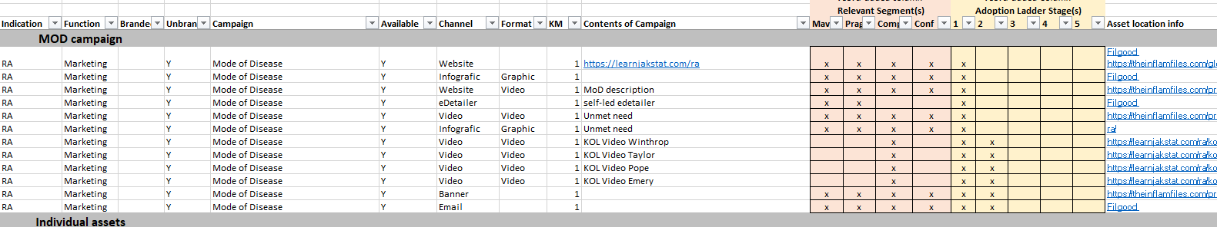
Existing Content
Assets developed or in progress by the international team are designed to meet RA JYSELECA objectives and convey key messages. As key messages are aimed at specific segments, assets are therefore segmented as well.
Mapping Assets to Segments & Adoption Ladder Stages
Currently a mapping process is underway to identify which segments are the most appropriate recipients of individual assets.
This file once completed will allow for local users to search the current content library for assets based on the relevant segment & adoption ladder stages they need.
*Please note that the image above is illustrative & intended to convey the process used to map content. Content mapping has not been finalized and thus the mapping shown above is subject to change.

Slide 8



Multi-segment Content
In some cases, the message source / asset will be the same for 2 customers, but the sales rep or speaker will emphasize different points of the content to align with segmented key messages.
Example: Why Jyseleca
“JYSELECA, the once-daily oral JAK-1 preferential inhibitor, has shown fast and sustained efficacy across all important clinical outcomes: ACR50/70 scores, radiographic progression as well as remission… The efficacy of JYSELECA is paired with low rates of JAKi associated adverse events, serious infections, herpes zoster and VTE, similar to those of adalimumab.”​
Mavericks: Emphasize efficacy
Pragmatists: Emphasize safety
Compassionates: Emphasize Patient Convenience (& Safety)

Slide 9
HCP Journeys Implications
Based on this mapping, and the ‘maturity’ of the market, we can develop HCP Journeys that deliver segmented content to HCPs.
However, a core principle we keep hearing is ‘simplicity’.
Our aim therefore needs to enable the execution of segmented campaigns that remains as simple as possible, avoiding too many journey documents.
(4x Adoption Ladders) x (5x HCP Journeys) = 20 Journey documents
We can therefore take the approach to create somewhat consolidated journeys that call out the variance in message or content based on the segment, thereby being simpler to execute, whilst minimising the loss of strategic differentiation.

